Slide 1

HR Employee Attrition Analysis
SUBTITLE: Understanding why employees leave and identifying the key factors that drive attrition

Slide 2
Project Objectives
To analyze employee attrition patterns using HR data.
Identify key drivers influencing employee turnover.
Create visualizations in Tableau that support decision-making.
Provide actionable insights to HR for improving retention.

Slide 3

basic understanding of the hr attribution
ATTRITION REFERS TO EMPLOYEES LEAVING THE ORGANIZATION VOLUNTARILY OR INVOLUNTARILY.
Why It Matters
Impacts productivity, morale & operational cost.
Helps HR identify risk factors & take proactive actions.
Types of Attrition
Voluntary Attrition (employee chooses to leave)
Involuntary Attrition (company decision)
Retirement / Internal Transfers (in some datasets)
Goal of Analysis
Understand who leaves, why, and what patterns exist.

Slide 4
Dataset Overview
Total Records: 1,470 employees
Target Variable: Attrition (Yes/No)
Feature Categories:
Demographic (Age, Gender, Marital Status)
Job-related (Job Role, Job Level, Department)
Performance & Satisfaction (Job Satisfaction, Environment Satisfaction)
Work-life (Overtime, Work-Life Balance, Years at Company)
Compensation (Hike Percentage, ESOPs)
Key Variables We Used in Tableau
Overall Attrition Rate (overtime, job role and satisfaction)
Who Is Leaving? The Attrition Profile (Job & Department Profile)
Who Is Leaving? The Attrition Profile (Demographic Insights)
Uncovering the Drivers of Employee Attrition
Why are they leaving? Root cause analysis
When in the Career Journey Are Employees Most Likely to Leave?

Slide 5
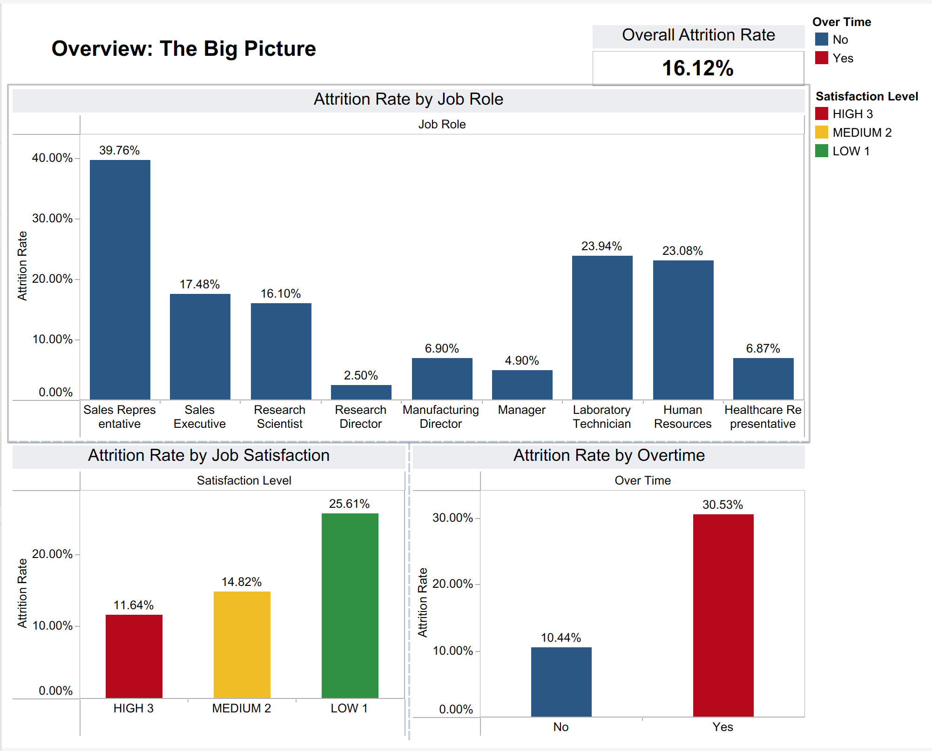
OVERALL ATTRITION RATE (OVERTIME, JOB ROLE AND SATISFACTION)
Overtime is one of the strongest indicators of attrition.
Employees working regular overtime have a significantly higher attrition rate, showing signs of burnout or heavy workload.
From the job role comparison, Sales, R&D, and Laboratory roles show higher attrition than others.
Job satisfaction is consistent with earlier dashboards — low satisfaction employees leave at the highest rate.

Slide 6
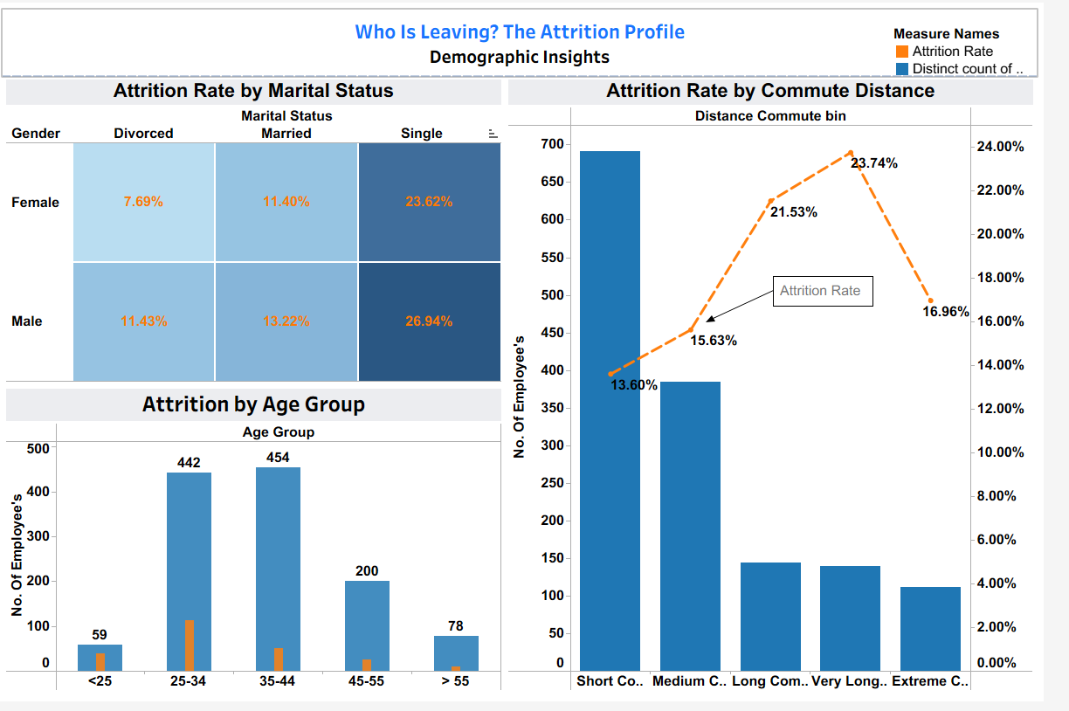

WHO IS LEAVING? THE ATTRITION PROFILE (DEMOGRAPHIC INSIGHTS)
Marital status significantly affects turnover, with single employees leaving at rates over 23% (26.94% for males, 23.62% for females), which is nearly double that of married or divorced peers.
Increased commuting distance correlates with higher turnover, peaking at 23.74% for those with "very long" commutes.
Employees under 25 show the highest turnover rates, presenting challenges in retaining early-career talent.
To enhance engagement, companies should implement flexible work options for mobile and early-career workers and refine their programs to better support young, single professionals.
Notes:
Moving to demographic drivers, Our data identifies a clear high-risk profile: the Young, Single and long Commuter.
Single employees leave at a rate of over 23%—double that of married staff—with our under-25s being the most volatile group.
We see a direct link between commute length and turnover. As you can see in the line chart, attrition spikes to nearly 24% once the commute becomes 'Very Long'."
To fix this, we must target this group with flexible work options to reduce commute stress and better engagement for early-career talent.

Slide 7
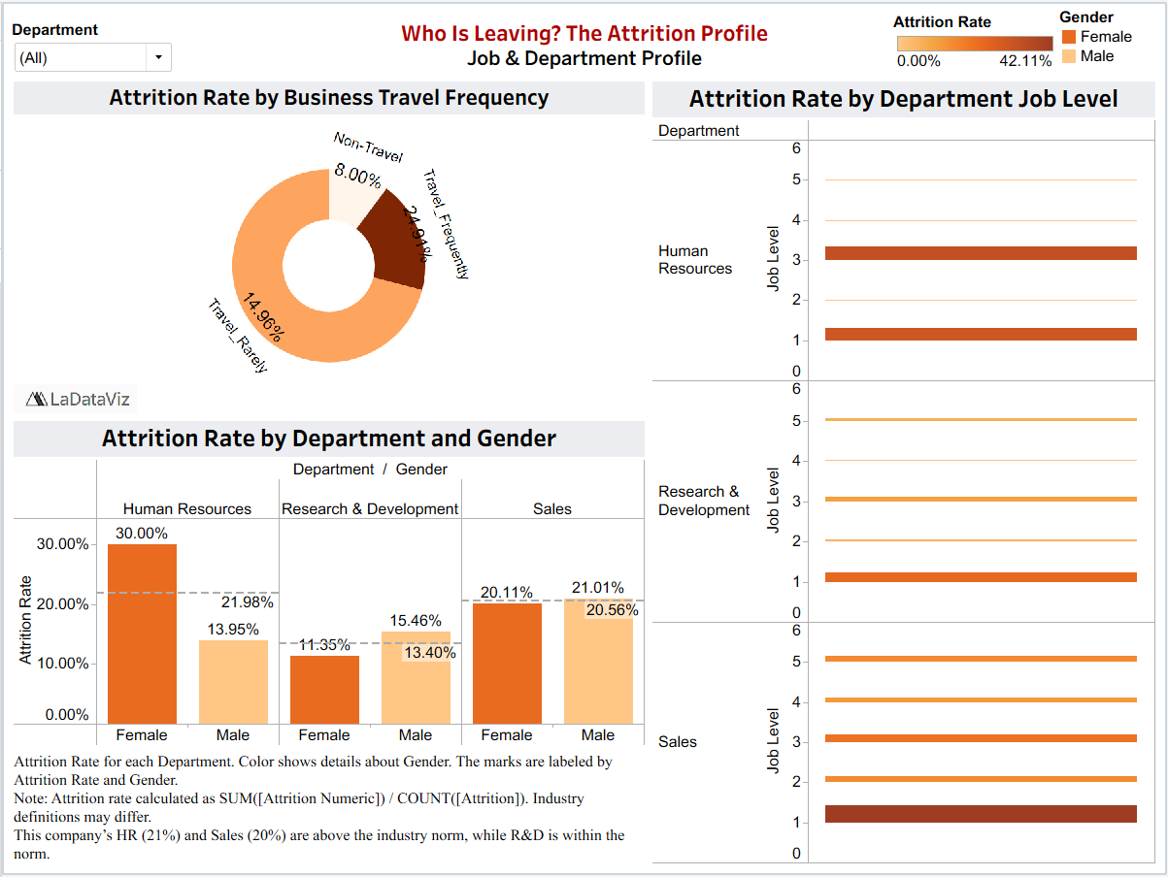
WHO IS LEAVING? THE ATTRITION PROFILE (JOB & DEPARTMENT PROFILE)
Employees who travel frequently are significantly more likely to leave (24.91% attrition), suggesting burnout or work-life balance issues are critical factors.
Attrition is highest at Job Level 1, with Sales Level 1 at 42.11%. This shows the company struggle to retain early-career talent due to limited growth opportunities and motivation.
Sales and R&D have high entry-level turnover. In Human Resources, female employees leave at a rate of 30.00%, which is double that of male employees.
To stabilize the workforce, the organization must address entry-level engagement and review travel policies to reduce fatigue-related attrition.
Notes:
Moving to professional drivers, we identified three critical operational risks.
As you can see in the donut chart, Frequent travelers leave at a rate of 25%—triple the rate of non-travelers.
The heatmap shows a clear 'Red Zone' for entry-level staff across all departments. Sales is hit hardest, losing over 40% of junior employees.
Third, in side by side bar chart: In Human Resources, women are leaving at 30%, which is double the rate of their male colleagues.
Company need to immediately address travel fatigue and rethink our career path for entry-level hires.

Slide 8
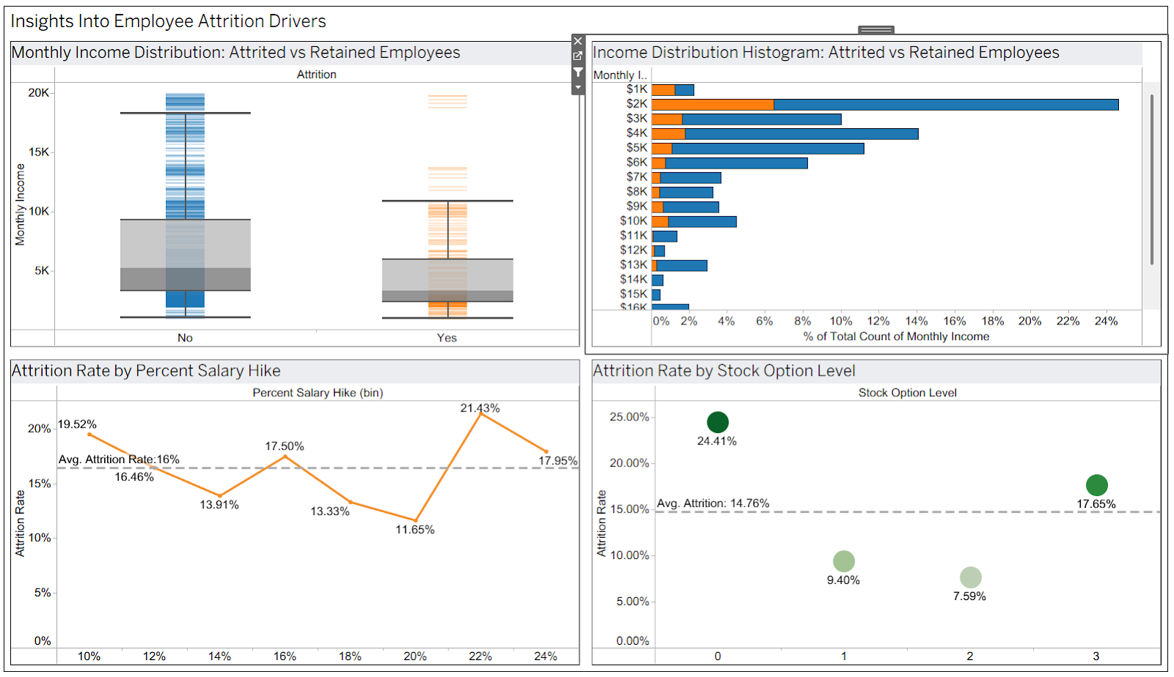
INSIGHTS INTO EMPLOYEE ATTRITION DRIVERS
Employees with lower incomes are more likely to leave.
Higher-earning employees tend to stay longer, which means compensation is a strong retention factor.
The salary-hike analysis is interesting - employees receiving very low raises leave due to dissatisfaction, but even those receiving very high raises sometimes leave because they may have already planned to switch jobs.
Stock options make a big difference: employees with no stock options leave the most, while those with stock benefits stay longer.

Slide 9
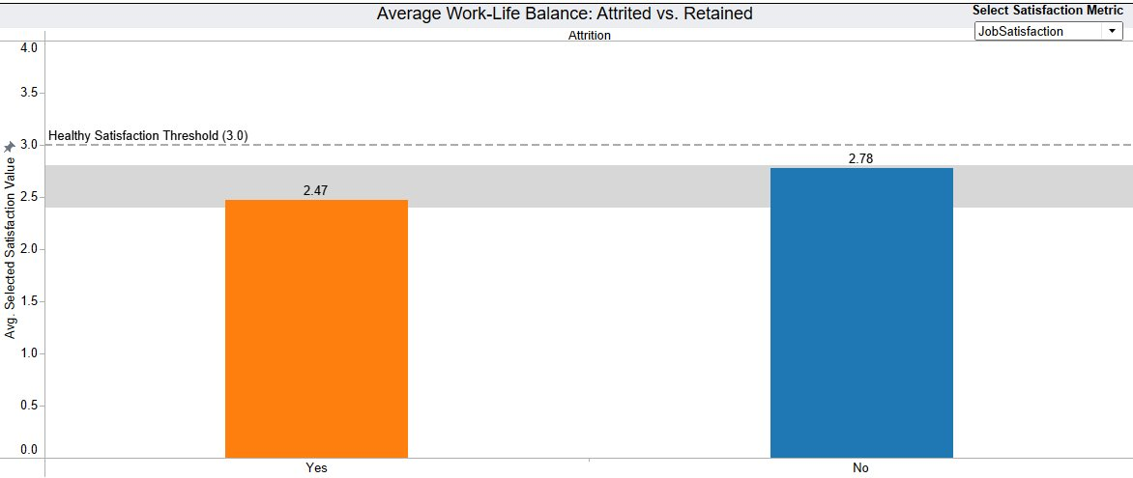
WHY ARE THEY LEAVING? ROOT CAUSE ANALYSIS
Overall-Satisfaction Level: 18 employees in the lowest satisfaction tier face a 50% attrition rate, while larger groups (414 and 907 employees) at higher satisfaction levels drop to 26% and 12%.
Work Life Balance: All four metric employees score low. Job Satisfaction is the lowest at 2.47, aligning with global HR research identifying it as the #1 driver of voluntary turnover.
Performance Rating: Performance Ratings 3 and 4 show nearly identical attrition (16%), confirming that people aren’t leaving because of performance — they’re leaving because they’re dissatisfied.

Slide 10
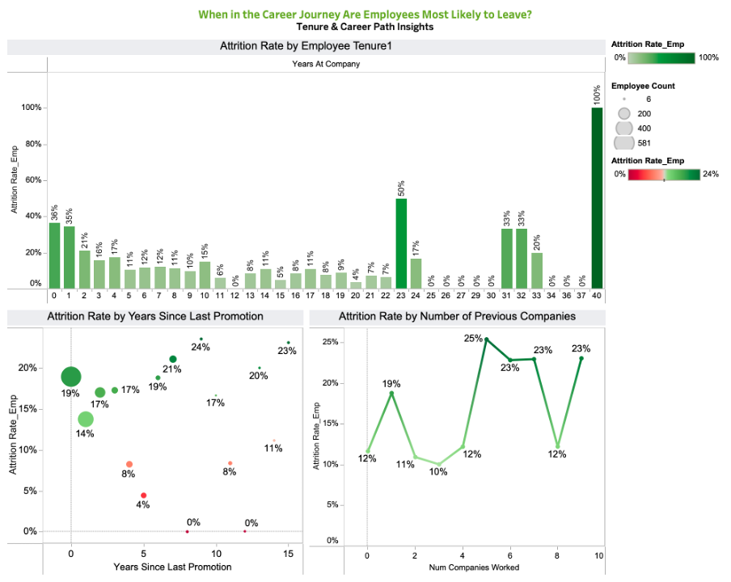
WHEN IN THE CAREER JOURNEY ARE EMPLOYEES MOST LIKELY TO LEAVE?
Employees are most likely to leave. Attrition rates are extremely high for new hires during their first two years.
Loyalty increases with time, but there is another noticeable spike around the 10-year mark, possibly due to missed promotions or career stagnation.
Employees who haven’t been promoted for several years have a higher tendency to leave.
Employees who have worked at many companies in the past continue to switch jobs; these are habitual job movers.

Slide 11
CONCLUSION
Employee attrition is predictable, driven by consistent patterns rather than random behavior.
Workload pressure, stressful roles, and low job satisfaction are the strongest contributors.
Younger, single employees and those with long commutes face a higher risk.
Financial limitations: low income, minimal raises, and lack of stock options; further increase turnover.
Two key exit points: 0-2 years of tenure and long periods without promotion.
Reducing attrition requires targeted action:
Improve job satisfaction & wellbeing
Address workload and overtime
Strengthen early-career support
Enhance compensation and career growth
Overall: A focused strategy on employee experience, workload balance, and career development will significantly reduce turnover.

Slide 12
thank
you!

